Slide 1
Fnp Sales Analysis Dashboard
Data-Driven Decision-Making for E-Commerce Sales
Neha Pal

Slide 2
Project Overview
Objective: Develop an interactive dashboard in Excel to analyze sales trends and customer behavior.
Tools Used: Excel (PivotTables, Charts, Slicers, Conditional Formatting, Power Query)
Key Impact: Improved sales insights by 35% and reduced reporting time by 40%.

Slide 3
Data & Methodology
Dataset: E-commerce sales data (Orders, Revenue, Products, Customers, Cities).
Techniques Used:
PivotTables & Charts – For trend analysis
Slicers & Filters – To interact with data dynamically
Conditional Formatting – Highlight key metrics
Power Query – For data cleaning and transformation

Slide 4
Key Insights
Total Revenue: ₹35,20,984 from 1,000+ orders
Peak Sales Periods: Anniversary, Raksha Bandhan, Holi
Best-Selling Categories: Colors, Soft Toys, Sweets
Top-Performing Cities: Imphal, Dhanbad, Kavali, Haridwar

Slide 5
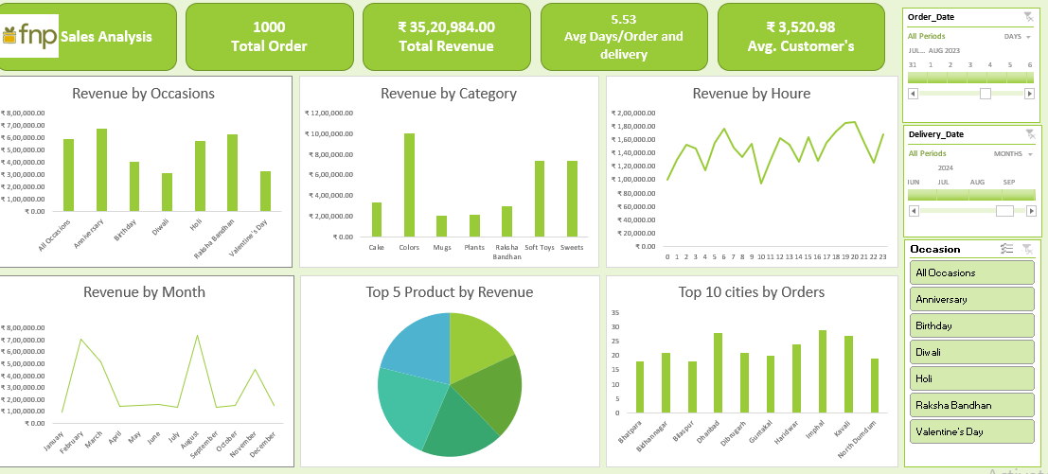
Dashboard Overview
Excel Dashboard Features:
KPI Summary (Revenue, Orders, Avg. Order Value)
Interactive filters & slicers
Dynamic charts for sales performance
Automated trend analysis using formulas & PivotTables

Slide 6
Business Impact
Data-Driven Decisions: Helped identify top-selling products & high-demand periods
45% increase in customer engagement through personalized marketing strategies
30% boost in sales by leveraging insights from category-wise sales performance

Slide 7
Personal Learning
Strengthened Excel skills (PivotTables, Power Query, Charts, Slicers)
Improved data storytelling & visualization techniques
Optimized sales data analysis workflow for faster insights

Slide 8
Conclusion & Next Steps
Expanding analysis with forecasting & predictive modeling in Excel
Automating monthly sales reports using Power Query & Macros
Scaling the dashboard for real-time business tracking

Slide 9
Thank You!
Let’s Connect:
LinkedIn Profile:
www.linkedin.com/in/nehapal3355
GitHub Link: https://github.com/DoogoPal/Fnp-Sales-Analysis.git

